Slide 1
Scrum Team 2
Sprint 2

Slide 2





What was pulled?
Total Estimated Points: 16
Total Completed Points: 16

Slide 3
Testing & Code Coverage
Unit Tests
Acceptance Tests
Code Coverage

Slide 4
Program Demos
We have designed and developed a demo that uses our code to parse arguments given to the demo.
There are four separate demos, each with a different outcome.
One passes with an optional flag false.
One passes with an optional flag true.
One fails with too many arguments.
One fails with too few arguments.

Slide 5
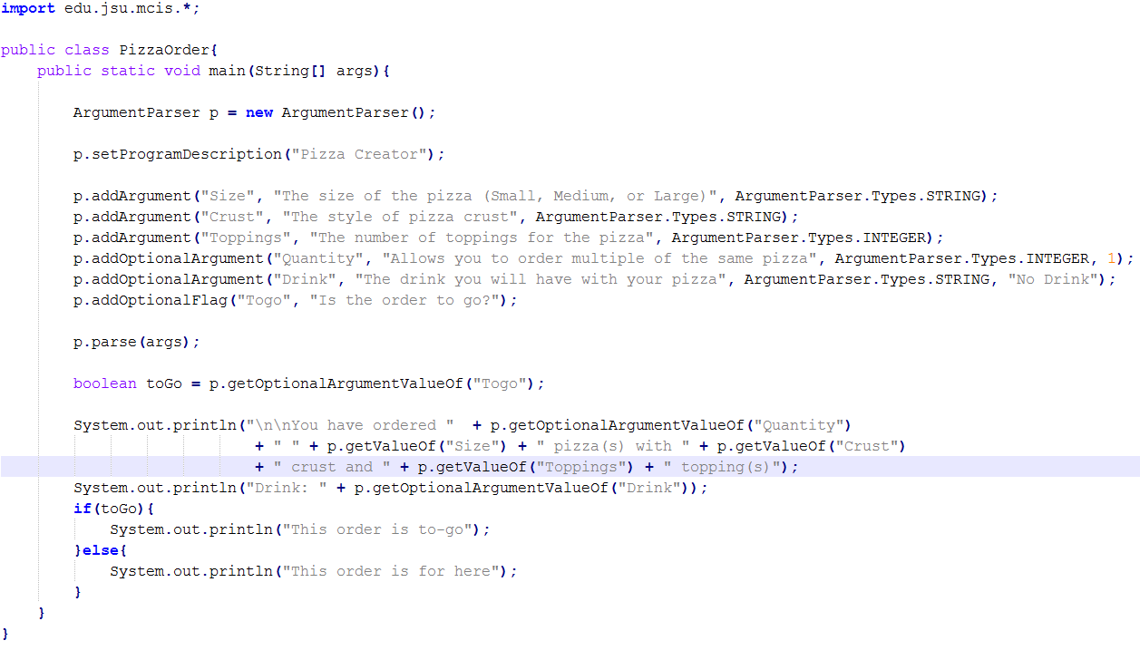

Slide 6
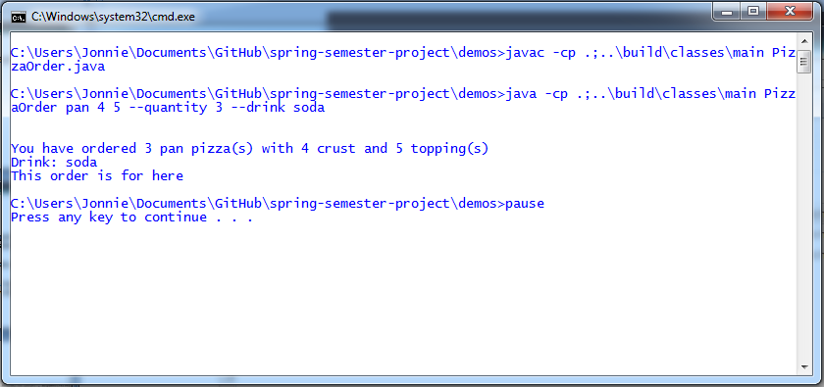
Demo #1 – Pass with Optional Flag False - Result

Slide 7
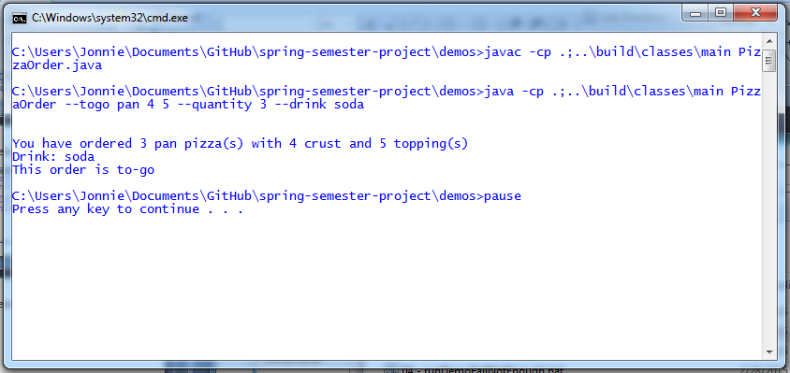
Demo #2 – Pass with Optional Flag True - Result

Slide 8
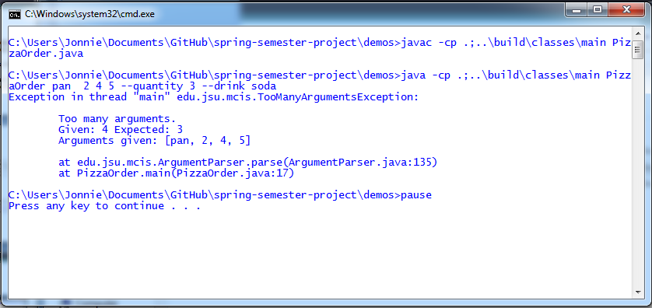
Demo #3 – Fail with Too Many Arguments- Result

Slide 9
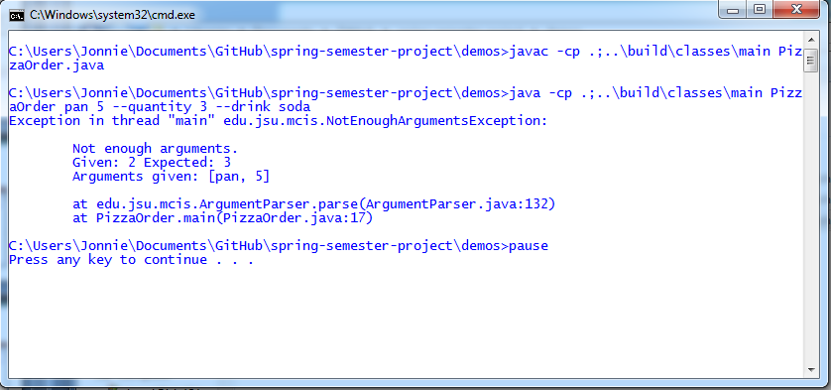
Demo #4 – Fail with Not Enough Arguments - Result

